Slide 1
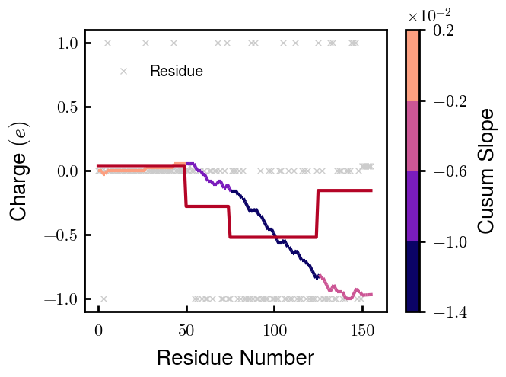
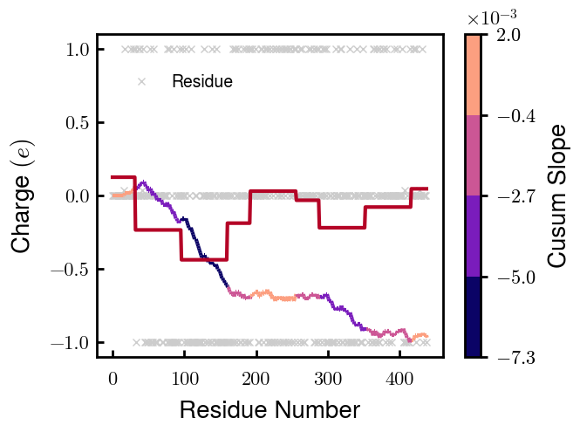

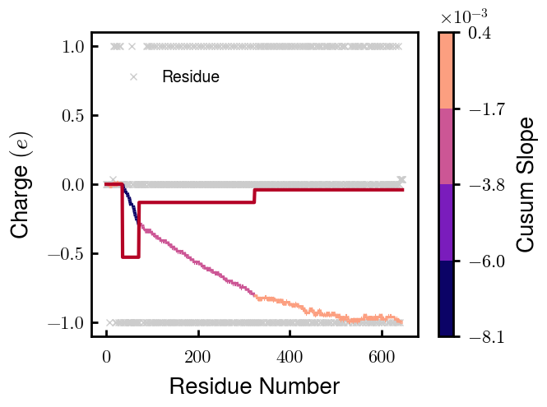
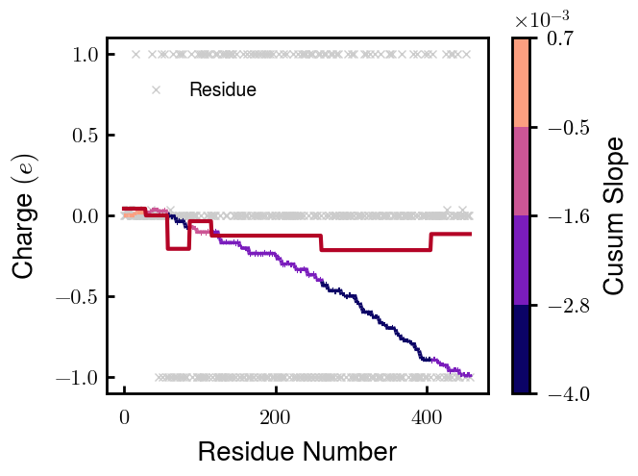
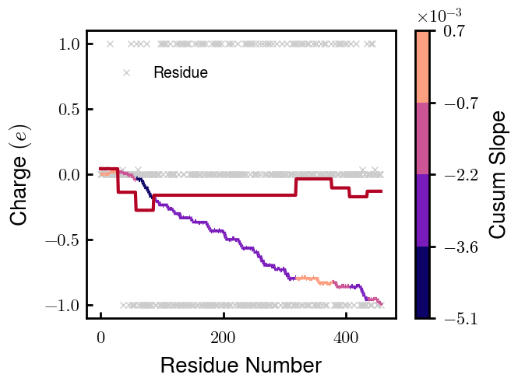
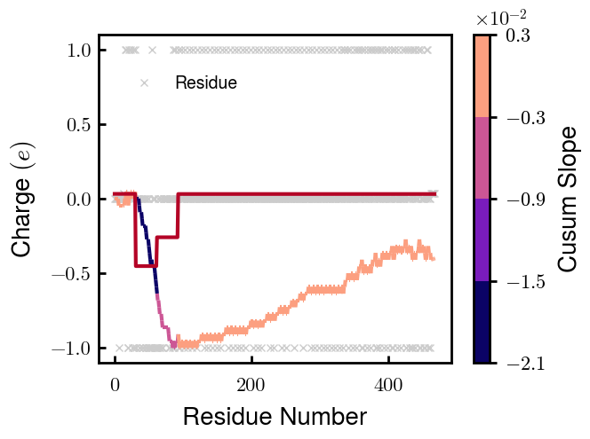
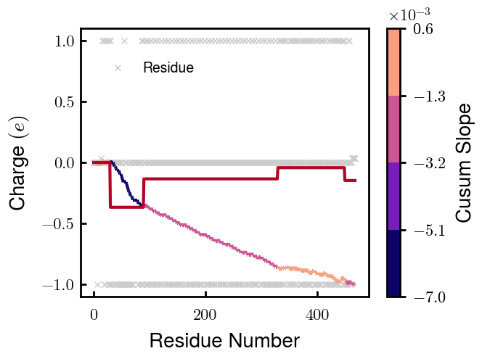
NFL
NFM
NFH
pNFH
NFM_S1
NFM_S2
NFH_DE
pNFH_DE

Slide 2
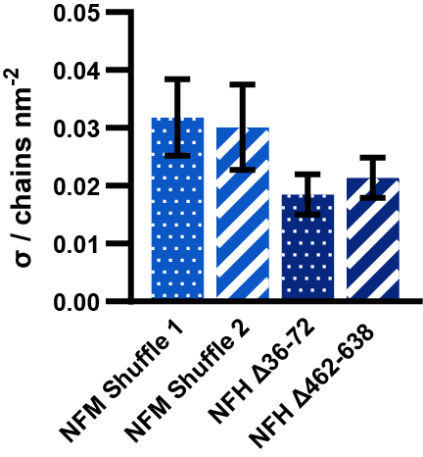
0.0313 (estimated)
0.0300 (estimated)
0.0212 (estimated)

Slide 3
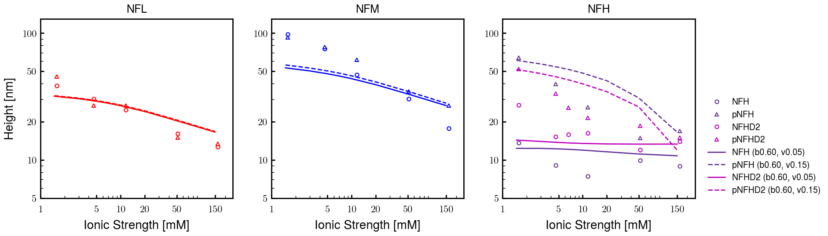
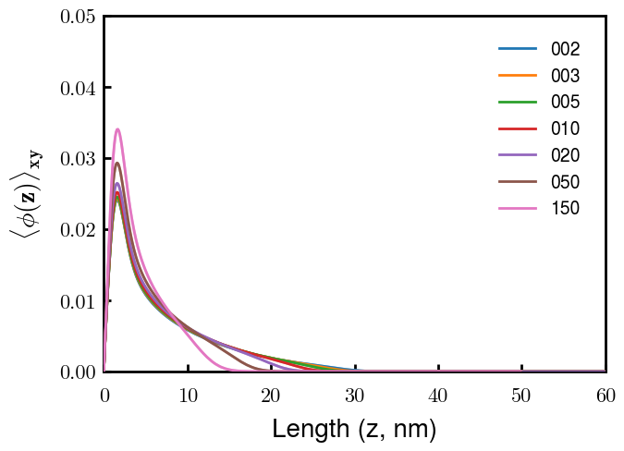
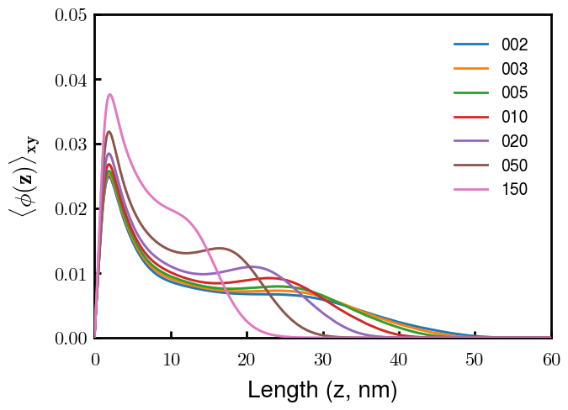
NFL
NFM
Next slide
Notes
pNFM running now; NFHb60v05c150 (cm225) running now
All non-phos same b,v
Phos L, M same as non-phos (few KsP)
Phos H 0.05 → 0.15 nm3
Potential improvements
Recheck pNFH(D2); no better option?
Recheck NFM; no better reasoning than b(s)?

Slide 4
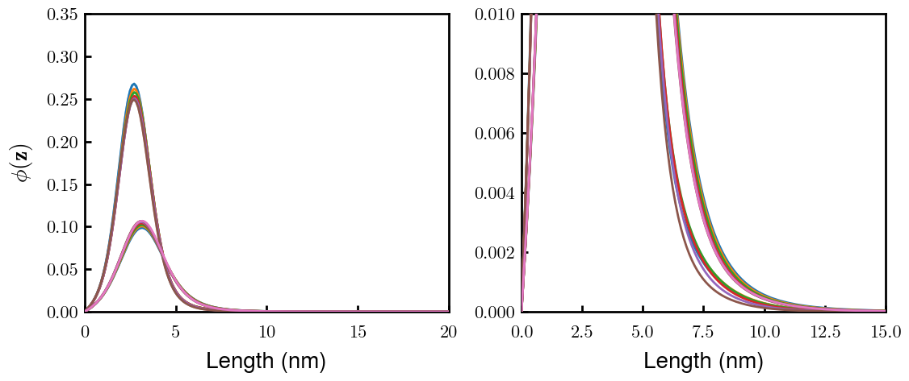
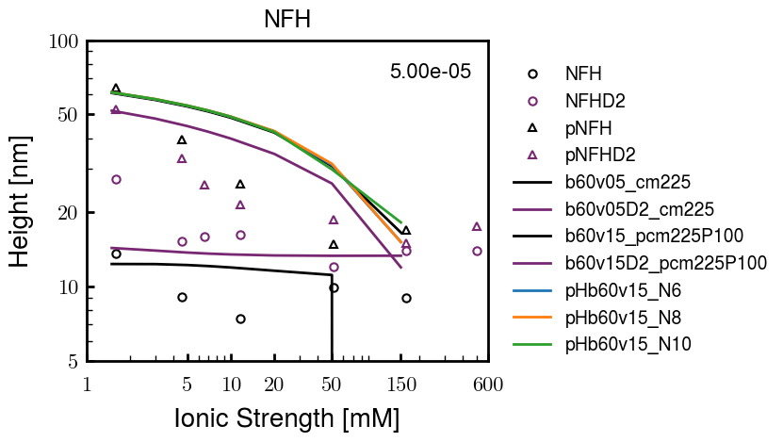
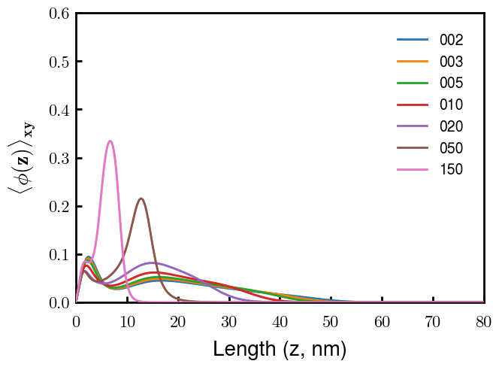
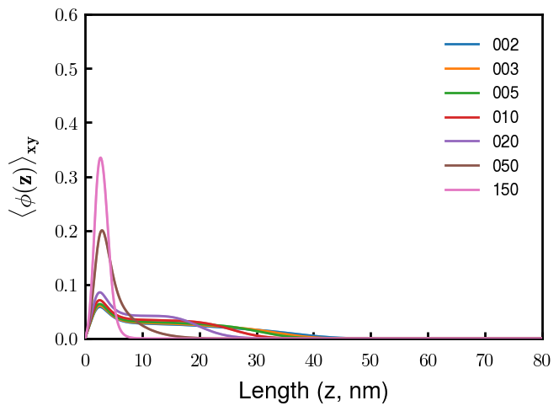
(p)NFH(D2)
NFH
NFHD2
pNFH
pNFHD2
(v = -1)
Points
v05 → v15 after phosphorylation
No condensed multilayer but worse fit

Slide 5
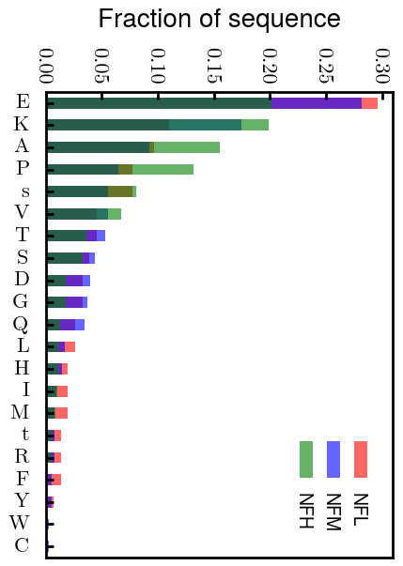
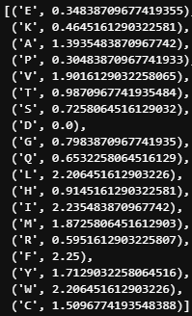
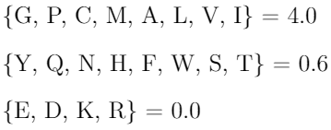
Chi (scaled)
Chi (BM 2023)
D: 3.65 (-1.00e);
E: 4.25 (-1.00e);
K: 10.53 (1.00e);
R: 12.48 (1.00e);
H: 6.00 (0.035e)
Biggest discrepancies between scaled and Zhulina: P (0.30 → 4.00), K (0.46 → 0.00), R (0.60 → 0.00)
(PKR has effect on pNFH; isolate P—currently seems too hydrophobic)

Slide 6
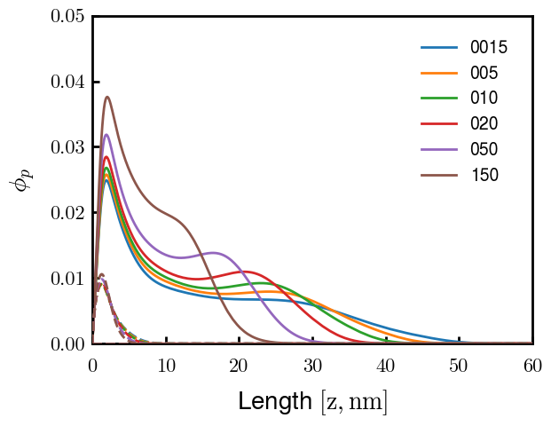
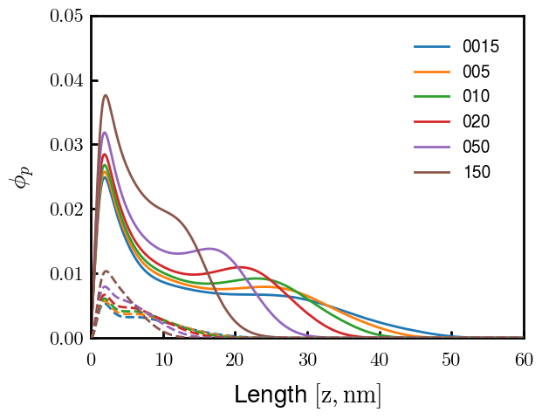
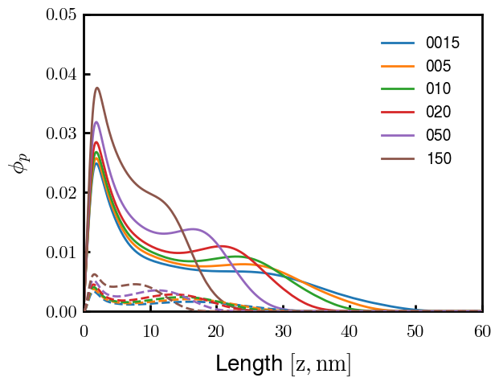
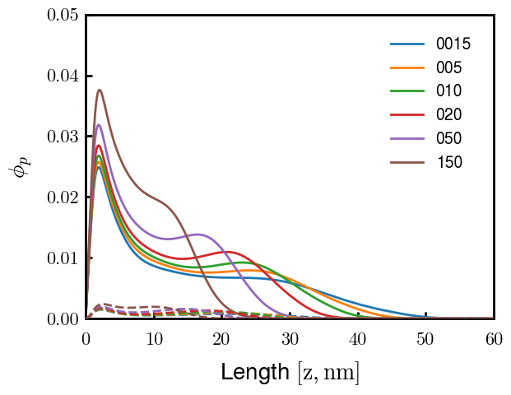
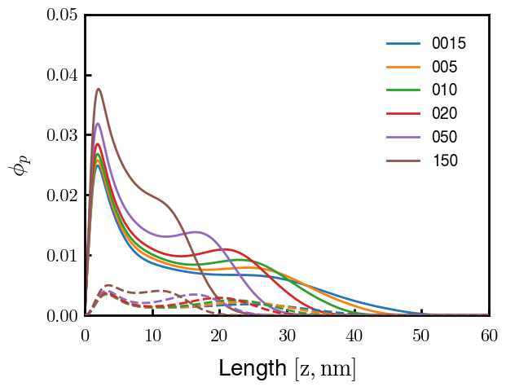

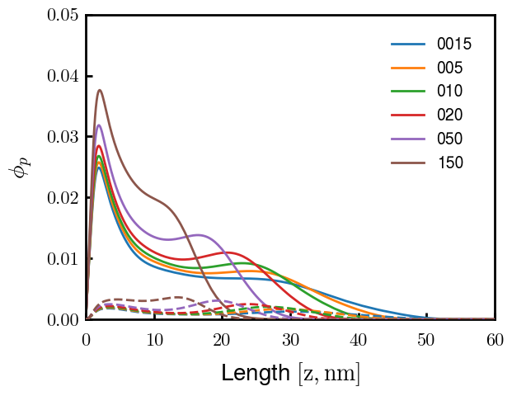

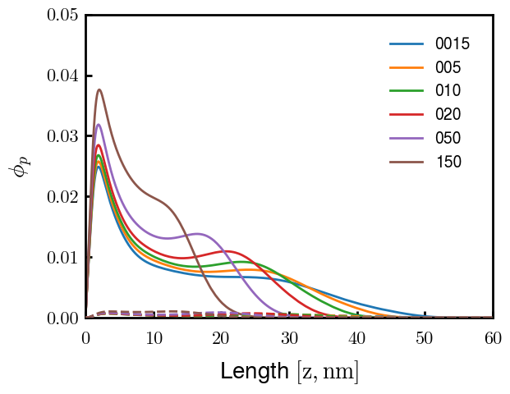
3
4
1
2
6
7
5
8
9

Slide 7
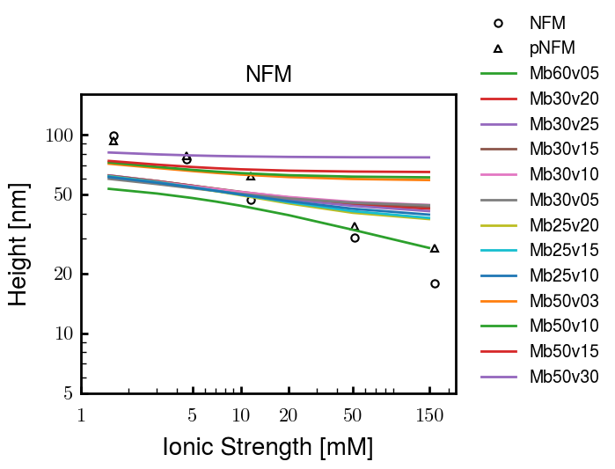
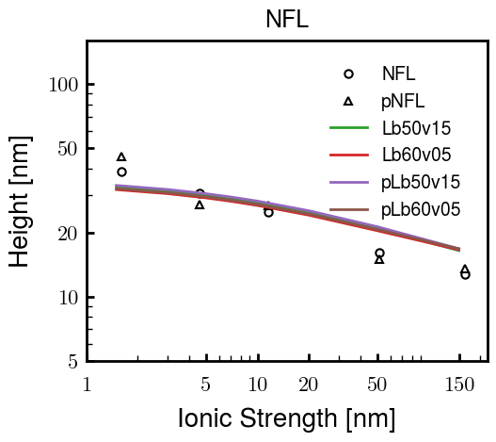
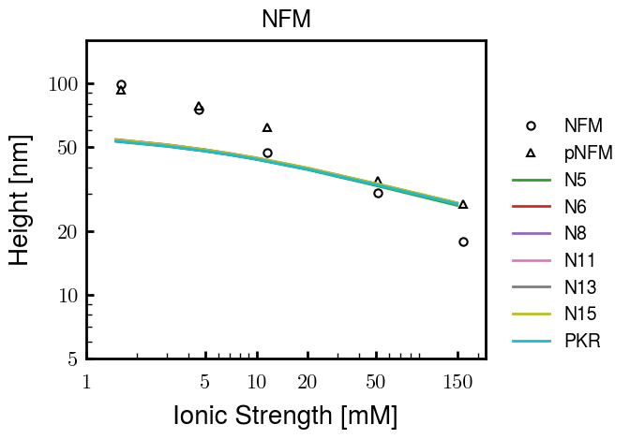
Other fits
pNFH P study next slide

Slide 8
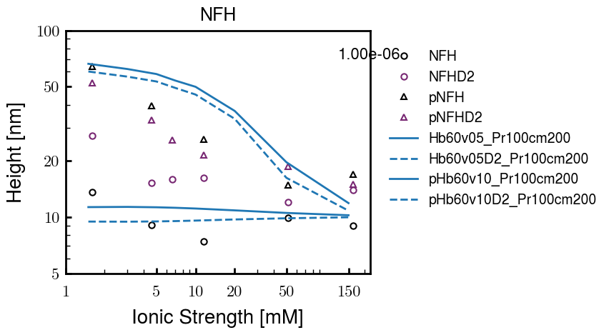
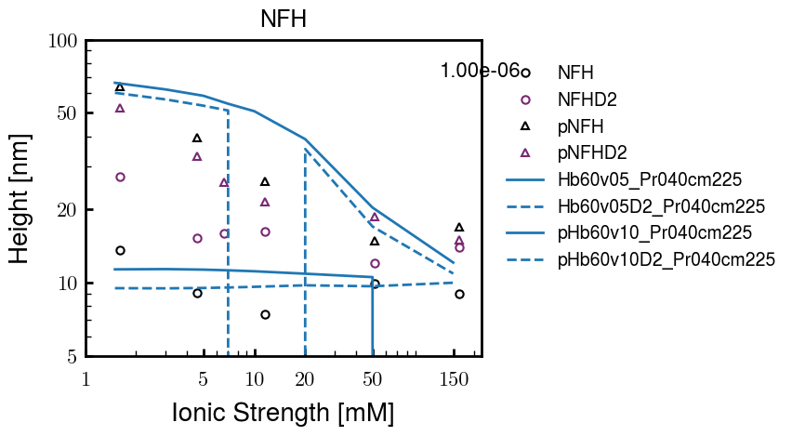

Slide 9
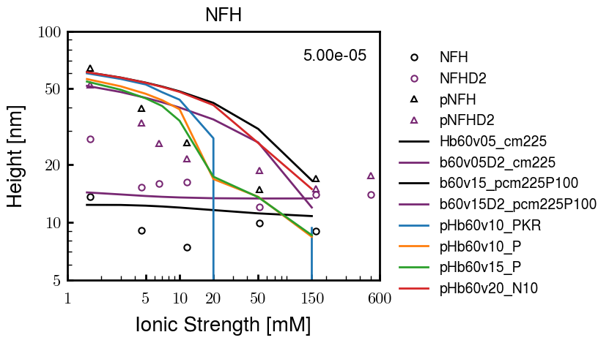
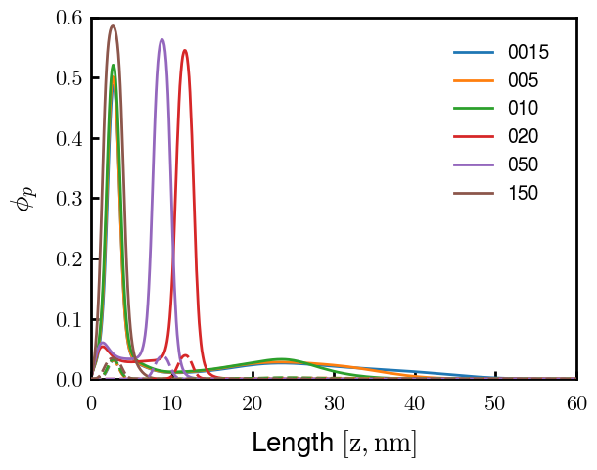
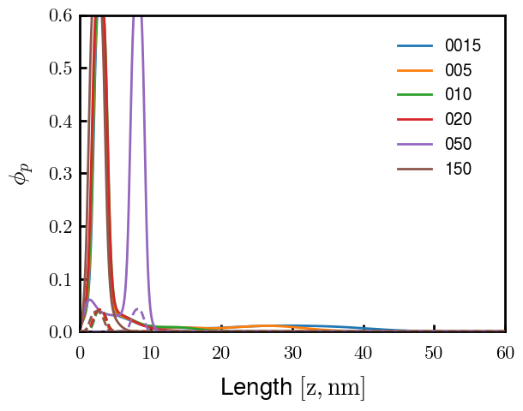
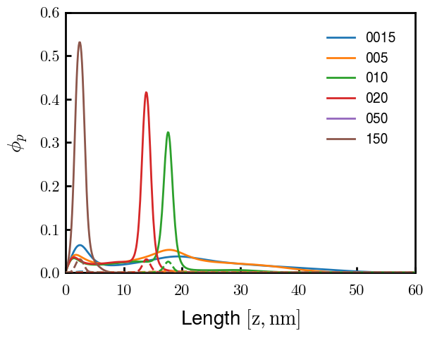
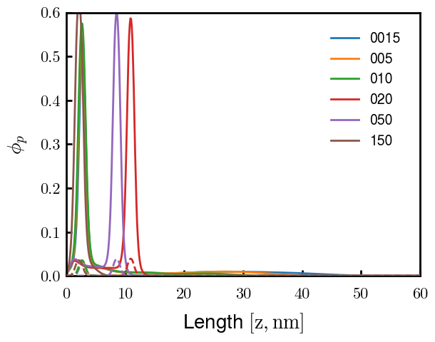
pHb60v15_PKR
pHb60v15_P
pHb60v10_PKR
pHb60v10_P
PKR identified as amino acids with high discrepancies between expt and Zhulina bins
P isolated and good trend (change P to max, 2.25)
Even though better H, some conformational changes. Try to avoid by decreasing (in prog).
Single outer peak may not be bad— “flower” conf?
At the very least, increase high cs height and check NFHD2 (and eventually NFL, NFM)
Ensure effect does not ruin NFH(D2) (after screening)

Slide 10
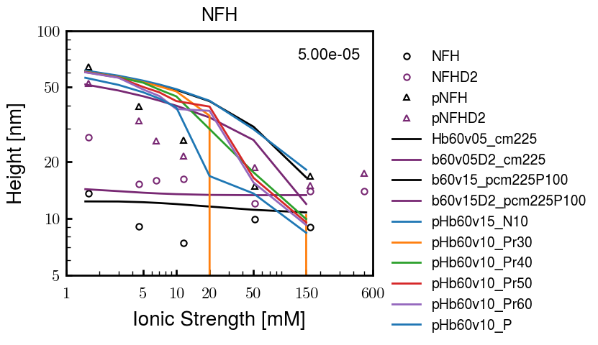
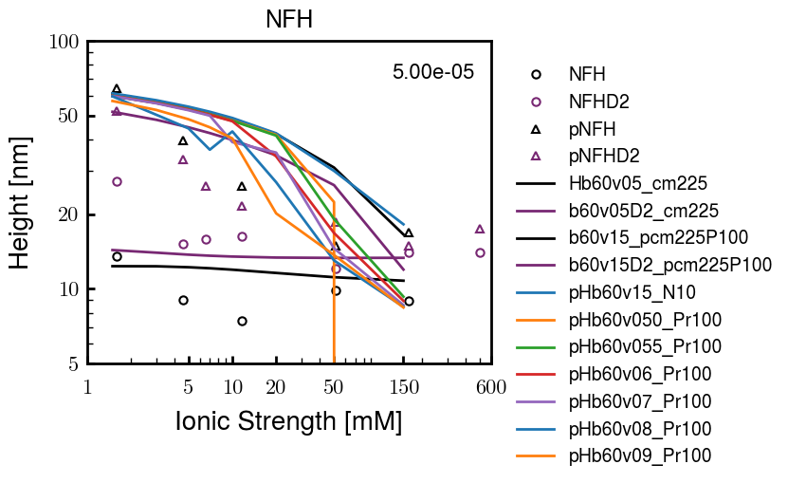
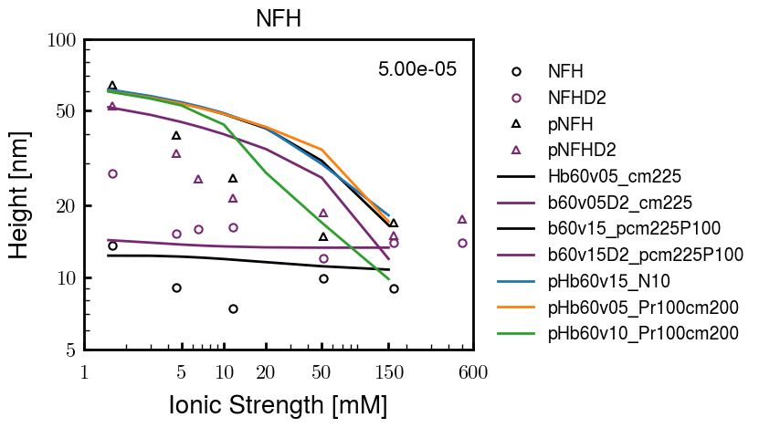

Slide 11
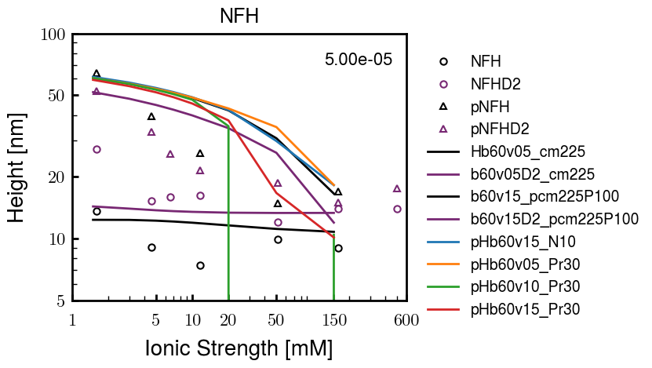
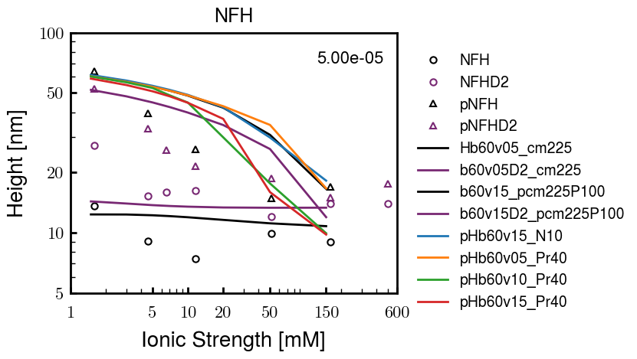
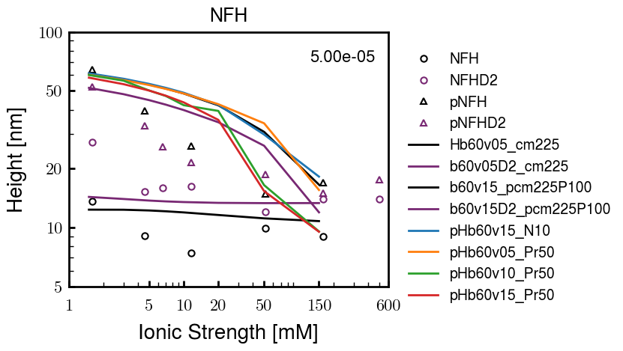
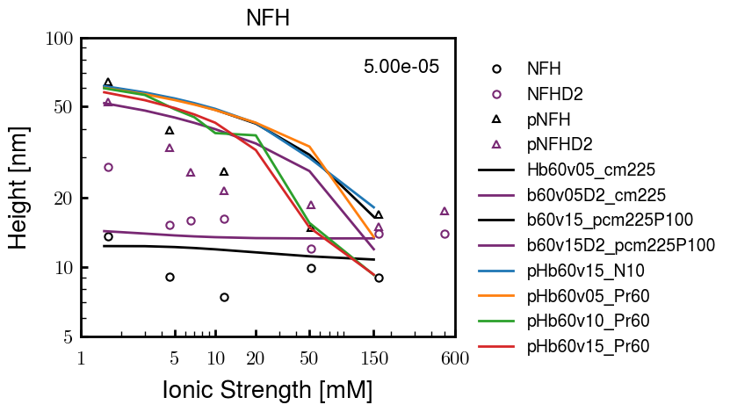
Pr100

Slide 12





Slide 13
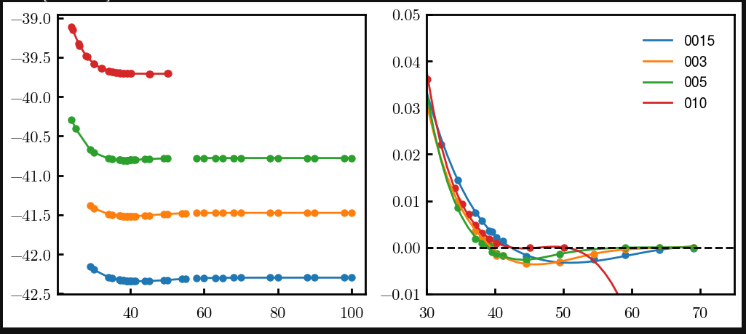
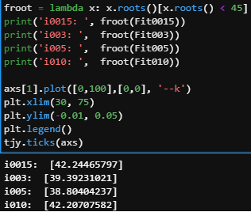
Try approaching surface

Slide 14



NFH (original); 31, 4
NFHD2; 40, 4
D2: delete 36-72
Rerun alg on D2
NFH (phos); 36, 4
NFHD2 (phos); 33, 4
Note: not currently doing this

Slide 15
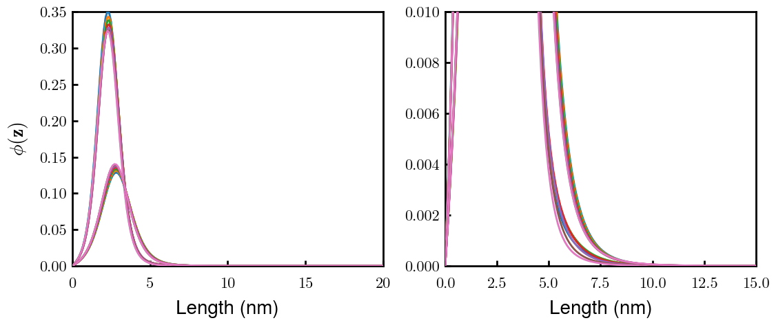
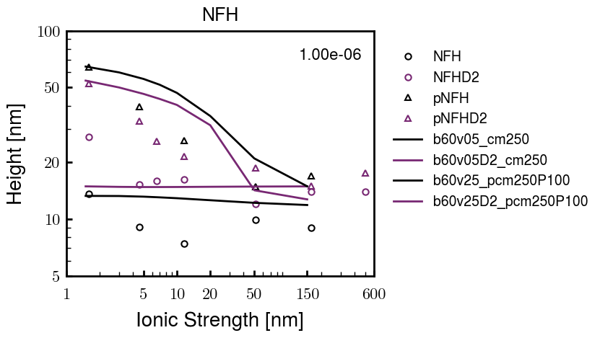
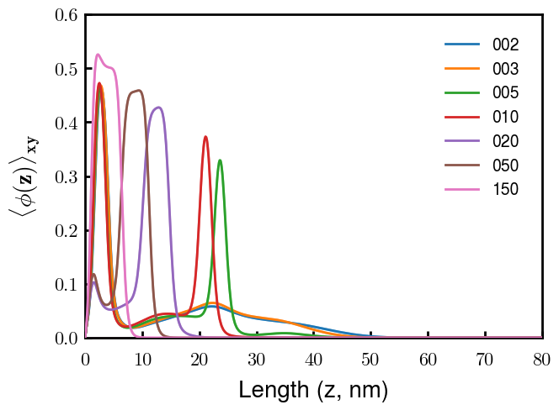
Best fit w/ consistent chi_max
NFH
NFHD2
pNFH
(v = -1)
Points
v05 → v25 after phosphorylation
Bilayer (trilayer for 5?) pNFH morphology

Slide 16
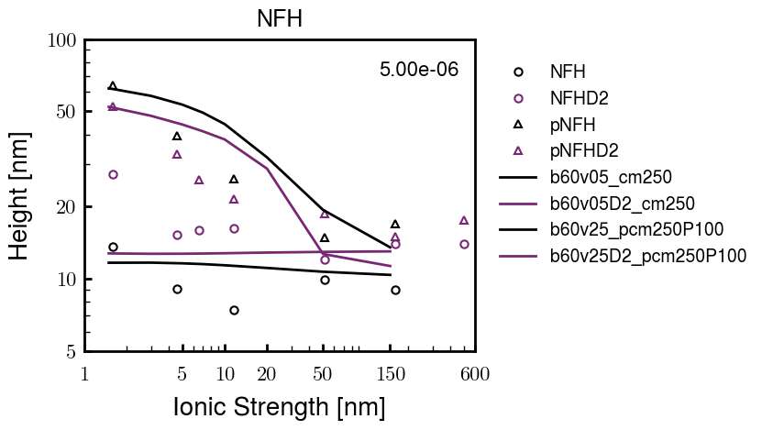
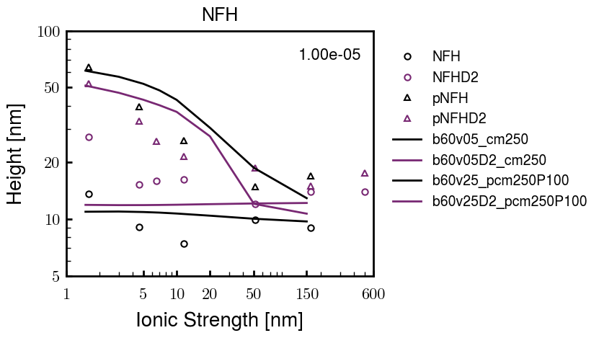
Same params as prev. w/ diff thresh

Slide 17
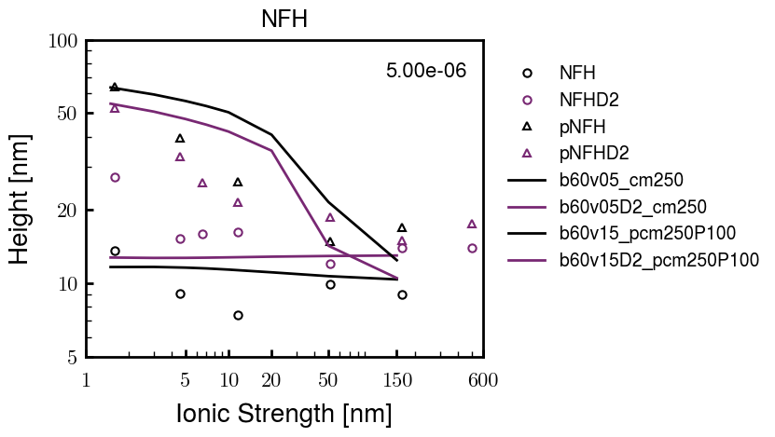



Find best without multilayer
pNFH
pNFH
(v = -1)
(v = -1)
Multilayer at 20

Slide 18

Best pNFH scaling fit (no regard to realistic)
pNFH
(v = -1)
Points
v05 → v25 after phosphorylation
cm200 → cm250 after phospho
Multilayer
Phospho < native

Slide 19






Native NFH

Slide 20







NFHD2

Slide 21




pNFH(D2)
4e-03

Slide 22





1e-06
4e-03
norm
4e-03
Try to bring pNFH down → {cmXX + PXX} only choice
norm
4e-03

Slide 23




3e-04
3e-04
3e-04

Slide 24





Heights.params : b60v05 cm200
norm
1e-06
1e-05
1e-04
4e-03

Slide 25






Heights.params : b60v05 cm250
norm
ylog
norm
ylin
1e-06
1e-05
1e-04
5e-03

Slide 26




Heights.params: b60v10 cm{200, 225}
norm
1e-06
1e-05
1e-04
5e-03

Slide 27



Slide 28

 | Slope Bins 4 | Smear Count 25
Block number | Alpha w/ Henderson Hasselbalch | Chi Chi_max = 2.2
[0 50] | 0.040012 | 1.160000
[50 75] | -0.278451 | 0.720000
[75 125] | -0.519707 | 0.608000
[125 156] | -0.154453 | 0.529032

Slide 29

 | Slope Bins 4 | Smear Count 31
Block number | Alpha w/ Henderson Hasselbalch | Chi Chi_max = 2.2
[0 31] | 0.001103 | 0.922581
[31 62] | -0.386873 | 0.703226
[62 93] | -0.290146 | 0.967742
[93 496] | 0.037164 | 1.098759
[496 527] | -0.064533 | 0.819355
[527 620] | 0.010682 | 0.756989
[620 647] | -0.103326 | 0.696296

Slide 30






Previous
New

Slide 31





Slide 32


Response to stimuli given composition
Same data
Effect of composition given environment

Slide 33


NFL, pH 7.44, phos 1.5e (locs from LCMS)
Non-phos NFL
Block number | Alpha w/ Henderson Hasselbalch | Chi Chi_max = 3.2
[0 50] | 0.040012 | 1.540000
[50 75] | -0.278451 | 0.960000
[75 125] | -0.519707 | 0.868000
[125 156] | -0.154453 | 0.690323
 | Slope Bins 4 | Smear Count 25
Block number | Alpha w/ Henderson Hasselbalch | Chi Chi_max = 3.2
[0 50] | -0.019988 | 1.540000
[50 75] | -0.278451 | 0.960000
[75 125] | -0.519707 | 0.868000
[125 156] | -0.154453 | 0.690323

Slide 34

NFM, pH 7.44, phos 1.5e (locs from LCMS)
 | Slope Bins 4 | Smear Count 32
Block number | Alpha w/ Henderson Hasselbalch | Chi Chi_max = 3.0
[0 32] | 0.079143 | 1.275000
[32 64] | -0.186340 | 1.125000
[64 96] | -0.327964 | 1.181250
[96 160] | -0.460694 | 0.787500
[160 224] | -0.124999 | 1.115625
[224 288] | -0.023510 | 0.956250
[288 352] | -0.242085 | 1.003125
[352 384] | -0.031302 | 1.125000
[384 416] | -0.123860 | 1.050000
[416 438] | 0.046945 | 1.281818

Slide 35





Bin 3 NFM, pH 7.44, phos 1.5e (locs from LCMS)

Slide 36




Bin 5 NFM, pH 7.44, phos 1.5e (locs from LCMS)

Slide 37



Phos 2 NFM, pH 7.44, phos 2.0e (locs from LCMS)

Slide 38



Chi 2.5 NFM, pH 7.44, phos 2.0e (locs from LCMS)

Slide 39



NFM, pH 7.44, non-phos

Slide 40


NFH, pH 7.44, phos 1.5e (locs from LCMS)
 | Slope Bins 4 | Smear Count 36
Block number | Alpha w/ Henderson Hasselbalch | Chi Chi_max = 3.2 | Chi Chi_max = 3.0
[0 36] | 0.000945 | 1.266667 | 1.20000
[36 72] | -0.527455 | 0.900000 | 0.85000
[72 324] | -0.208376 | 1.729365 | 1.628571
[324 396] | -0.111195 | 1.416667 | 1.333333
[396 432] | -0.152824 | 1.344444 | 1.266667
[432 647] | -0.033955 | 1.077209 | 1.015814

Slide 41




Phos block dashed
Phos block dashed

Slide 42



Best are b3.0 v2.0 and b3.0 v3.0, but max H not high enough
Possible solutions:
Lower chi_max
Change aa_disc to have more charge
Force spectra?
Better for low salt, but high salt will melt brushes together

Slide 43



M1
pMx5

Slide 44



b3.00; v1, 2
b4.00; v2, 2.5, 3, 5, 10
b5.00; v3, 10, 15, 40
53 Nk
39 Nk
32 Nk

Slide 45
Binary results

Slide 46



Matrix Approach
Updated 04/04/2023

Slide 47














H Vol decrease (by v)
H Vol decrease (by b)
Desired “linearity” by tuning /thresh/ based on polymer density of expelled NFL
L Vol decrease (by b)
Comes at severe cost of overall height. Have to minimize outer concentration to approach pure thresh of 1e-06

Slide 48














H Vol decrease (by v)
H Vol decrease (by b)
Chimax 3.5
Desired “linearity” by tuning /thresh/ based on polymer density of expelled NFL
L Vol decrease (by b)
Comes at severe cost of overall height. Have to minimize outer concentration to approach pure thresh of 1e-06

Slide 49








F (3.5)
Chimax 3.5
Chimax 3.0
Scaled by 1.5
Scaled by 1.6
Scaled by 1.6
Scaled by 1.5
Scaled by 1.5
Scaled by 1.5
Scaled by 1.8
Scaled by 1.8

Slide 50
















Last test: same stiffness factor (b^3/v0) but with varying total volume

Slide 51












H Vol decrease (by v)
H Vol decrease (by b)
a2C_30
a2D_30
a2E_30
Rerun for Cs
b1C_30
b1D_30
b1E_30
L Vol decrease (by b)
a1C_30
a1D_30
a1E_30
g1C_30
g1D_30
g1E_30
Rerun for Cs

Slide 52












H Vol decrease (by v)
H Vol decrease (by b)
a2C
a2D
a2E
b1C
b1D
b1E
Block 4 (NFL end)
L Vol decrease (by b)
a1C
a1D
a1E
g1C
g1D
g1E

Slide 53









H Vol decrease (by v)
Chimax 3.5
H Vol decrease (by b)
a2C_30
a2D_30
a2E_30
b1C_30
b1D_30
b1E_30
L Vol decrease (by b)
a1C_30
a1D_30
a1E_30
g1C_30
g1D_30
g1E_30

Slide 54







For i as L and H:
Pure height profiles
Mixed height profiles
Current L library
Current H library
Skip; marginal increase in vol prob not enough
Move onto chi3.0; larger NFL vol library

Slide 55





NFL
All plotting wrong L pure; look only at purp
NFH
H volume too low to neutralize L (v = 31 nm3/c)

Slide 56







H volume v = 60 nm3/c

Slide 57







H volume too low to neutralize L

Slide 58










NFH, V = 70
L30

Slide 59





NFH & NFL v = 0.15
a2D
b1D
g1D

Slide 60





Based on NFH b5v15c3, apply VL = VH
NFL and NFH are from same amino acids but diff chain lengths. Should VL = VH?
L30 / H70
L80 / H20
L30 / H70
L80 / H20

Slide 61






L30 / H70
L80 / H20
L30 / H70
L80 / H20

Slide 62
L Fitting

Slide 63


VL = VH

Slide 64







Try b change, v same as H (0.15)
Phi unrealistic (?)
Phi unrealistic
Phi very unrealistic
Phi very unrealistic

Slide 65






Try similar params to H
5.6
11.2
16.8
28
56
7.5
11.25
18.75

Slide 66







Try similar params to H, b0.36
7.8
15.6
23.4
31.2
Unrealistic vol
Not very sensitive to v; not high enough to intersect neighboring chains (function of b and sigma)

Slide 67


Continuation from prev params

Slide 68







v2.7 and some fine
b1.50 v2.7 c3.2
b1.75 v2.7 c3.2
b1.75 v2.5 c3.2
b1.75 v2.5 c3.0
b2.0 v2.7 c3.2
b2.25 v2.7 c3.2
b2.50 v2.7 c3.2
Phi too small to decrease v0

Slide 69










b2.0 v10.0 c3.0
b2.0 v8.0 c3.0
b2.0 v6.0 c3.0
b2.0 v4.0 c3.0
b2.0 v2.0 c3.0
Phi limit
b1.8 v10.0 c3.0
b1.8 v8.0 c3.0
b1.8 v6.0 c3.0
b1.8 v3.0 c3.0
b1.8 v2.0 c3.0
Phi limit

Slide 70





b1.6 v10.0 c3.0
b1.6 v8.0 c3.0
b1.6 v6.0 c3.0
b1.6 v2.0 c3.0
b1.6 v1.5 c3.0
Phi limit

Slide 71









b2.0 v2.7 c3.2
b3.0 v3.5 c3.5
b3.0 v7.0 c3.5
b3.0 v7.0 c3.0
Phi too small
Phi too small to decrease v0
b4.0 v12.0 c3.0
b5.0 v20.0 c3.0
b5.0 v20.0 c4.0
b5.0 v5.0 c3.0
b5.0 v10.0 c3.0
Phi too small to decrease v0

Slide 72





v20
b5.0 v20.0 c3.0
b4.5 v20.0 c3.0
b4.0 v20.0 c3.0
b3.5 v20.0 c3.0
v10
b5.0 v10.0 c3.0
b4.0 v10.0 c3.0
b3.0 v10.0 c3.0
b2.0 v10.0 c3.0

Slide 73




b2.00 v2.70 c3.20
b2.00 v2.75 c3.20

Slide 74
NFH fitting (from NFL best fit)

Slide 75








b1.00, v0.50, c3.2
b2.00, v4.00, c3.2, th2.5e-02
b1.00, v2.00, c3.2
b1.00, v1.00, c3.2

Slide 76
Mixture

Slide 77



Slide 78


b = 0.75

Slide 79





Slide 80
b = 1.0

Slide 81





Slide 82
b = 1.25

Slide 83




Chi 2.6
Bad vol frac

Slide 84








b25v0
b25v1
b25v2
b25v3

Slide 85




Chi 2.8
Bad vol frac

Slide 86





Slide 87
b = 1.50

Slide 88






Chi 2.8
Bad vol frac

Slide 89





Slide 90

b = 2.00
v4 = 0.25*b^3

Slide 91


Bad vol frac

Slide 92



Slide 93
Fine tune

Slide 94



b1.25, v1.95, c3.0
b1.50, v3.38, c3.0
b2.00, v4.00, c3.0
Norm seems to capture kinked behavior

Slide 95




Slide 96



b1.25, v1.95, c3.2
b1.50, v3.38, c3.2
b2.00, v4.00, c3.2

Slide 97




Slide 98


b1.25
b1.50
b2.00
c2.8
c3.0
c3.2

